Slide 1
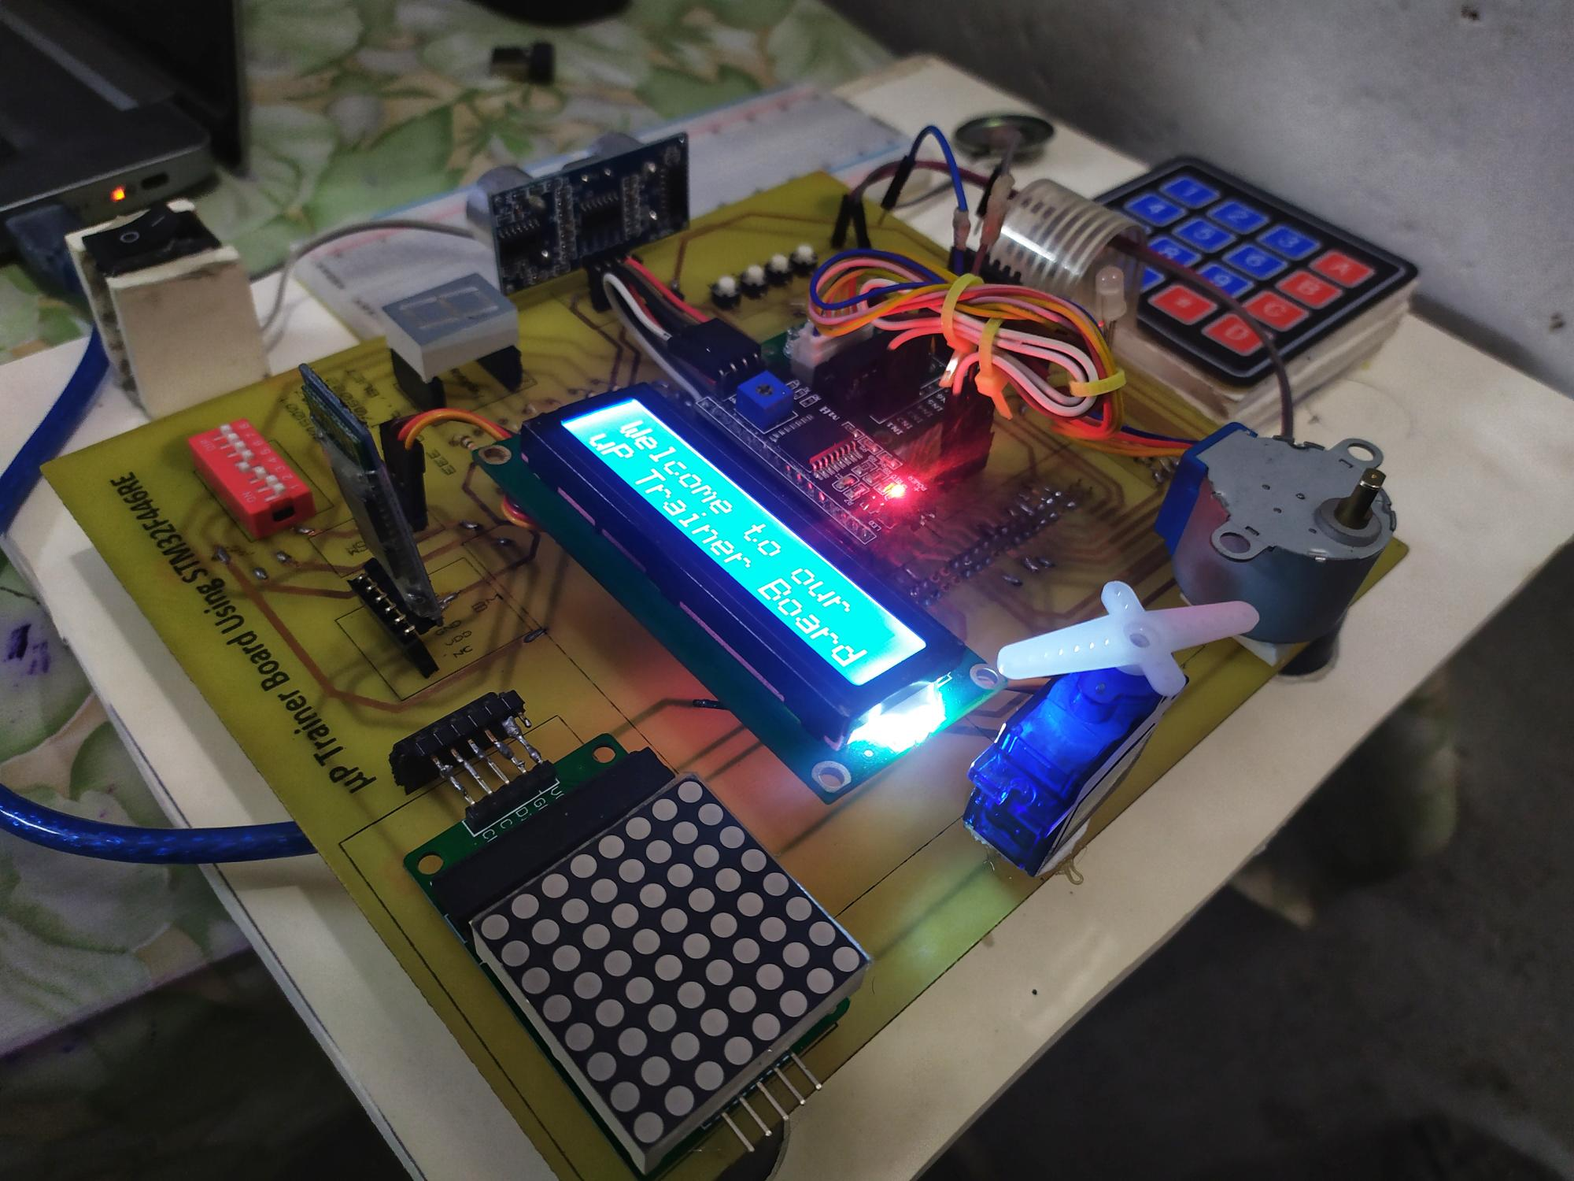

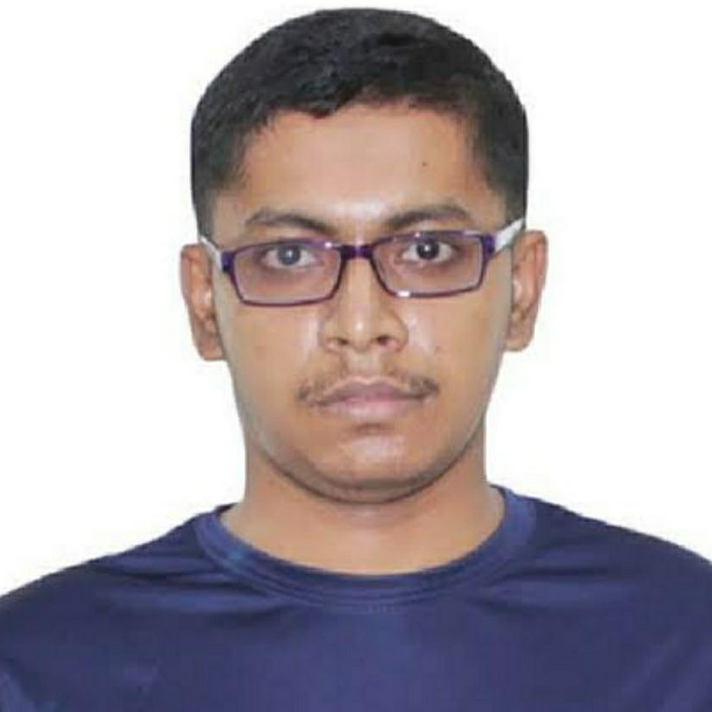
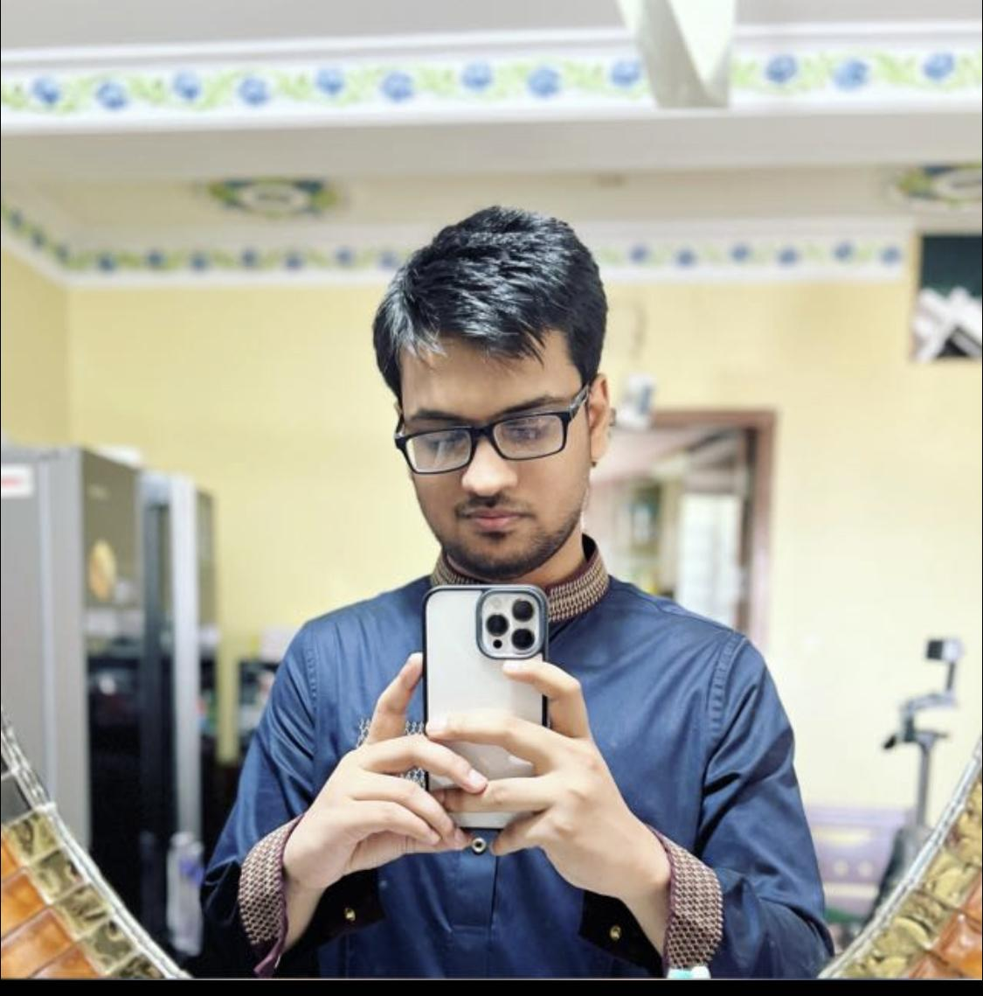

uP Trainer Board Design Using STM32F446
Submitted by – Group A1
Mrinmoy Kundu
1706001
Md. Rafiqul Islam Rafi
1706007
Jahid Hasan Tushar
1706009
Voktho Das
1706022

Slide 2
Outline
Summary
Introduction
Design (Schematic and PCB)
Implementation (Demo)
Analysis and Evaluation
References
Video Demonstration

Slide 3
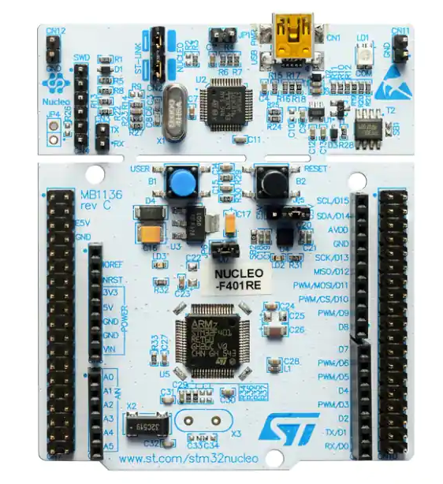
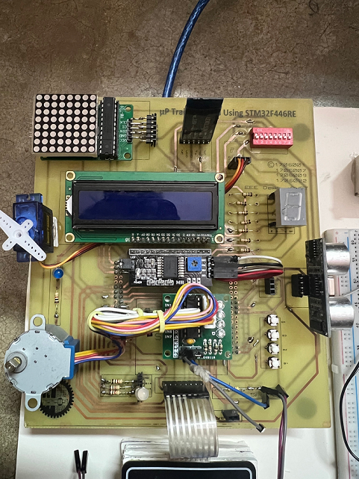
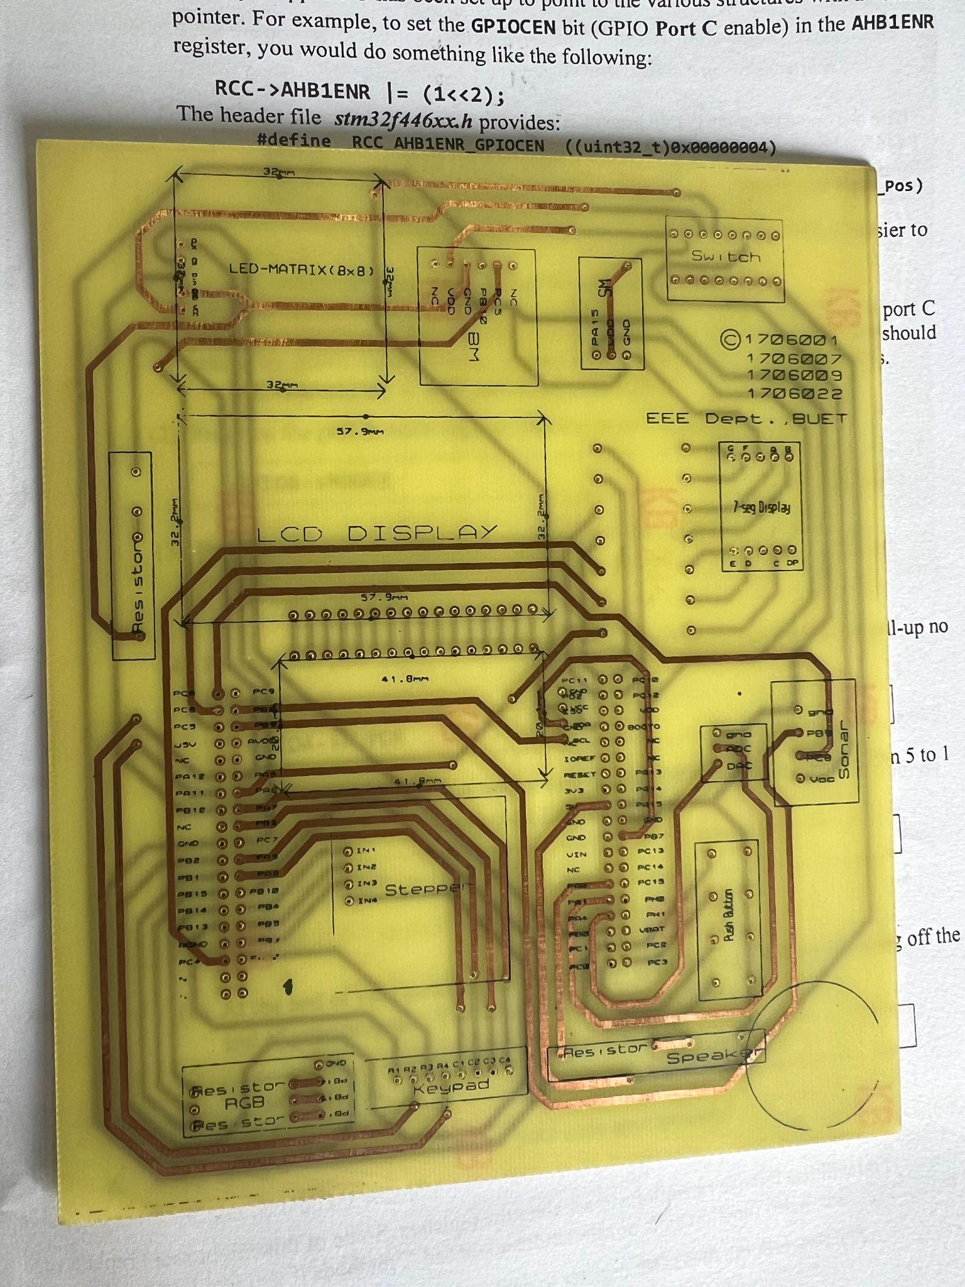
1. Summary
Driving towards destination
Individual Circuit testing using STM32F446 microcontroller
PCB containing all circuitry of our targeted task
Final trainer board containing different features
Presented by: 1706009

Slide 4
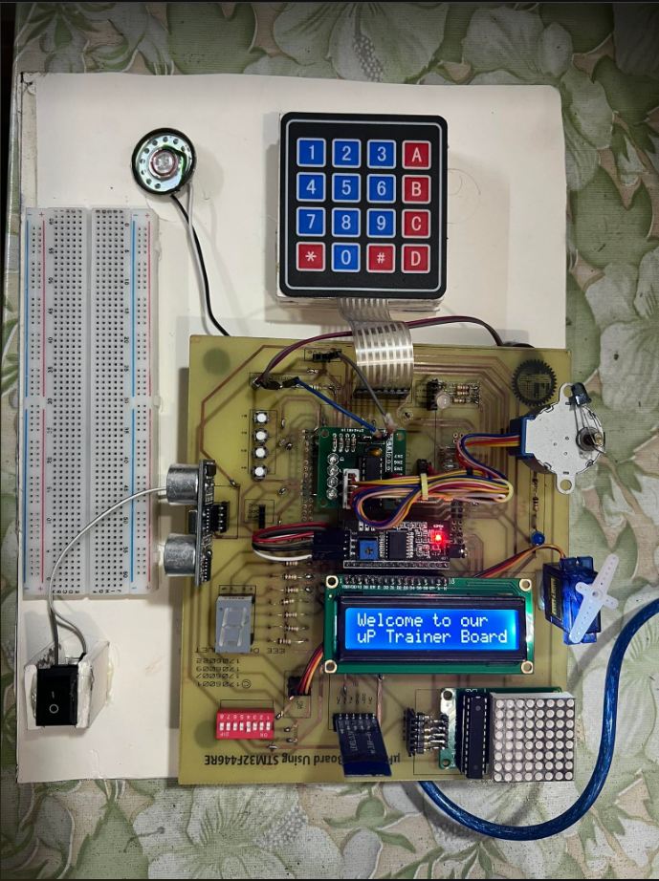
2. Introduction
The STM32F446xC/E devices are based on the high-performance Arm® Cortex®-M4 32-bit RISC core operating at a frequency of up to 180 MHz. The Cortex-M4 core features a floating point unit (FPU) single precision supporting all Arm® single-precision data-processing instructions and data types.
The STM32 Nucleo-64 board provides an affordable and flexible way for users to try out new concepts and build prototypes by choosing from the various combinations of performance and power consumption features, provided by the STM32 microcontroller. For the compatible boards, the external SMPS significantly reduces power consumption in Run mode. The STM32 Nucleo-64 board comes with the STM32 comprehensive free software libraries and examples available with the STM32Cube MCU Package.
Presented by: 1706009

Slide 5
Features of the uP Trainer Board
Using Nucleo-64 STM32F446RE, our project goal is to implement a compact trainer board which will host the following functionalities
LCD
Will be integrated to all the experiments
7-segment display
LED matrix 8x8
Serial communication.
I2C (With LCD Driver)
USART (With Bluetooth module)
SSI (With MAX7219 Driver)
Generation of PWM signal
LED dimmer
RGB LED
ADC and DAC
Note synthesis
Stepper motor
Servo Motor
Sonar
Input device
Key board
Push button
Presented by: 1706009

Slide 6
3.1 Design: Workflow
We have arranged our workflow in the following manner
Assembling and Debugging(29/8/22)
Finally, all the modules are assembled on to the PCB board and debugged for any faults.
Proteus Simulation (12/7/22)
As a first test step, we demonstrated proof of concept and physical circuit of each experiment in Proteus software using STM32f401re
05
01
04
Printing(24/8/22)
After verifying all the steps, we finally printed the PCB board.
Breadboard Implementation and Coding with CubeIDE and Keil uVision (26/7/22)
After verifying workabilities of the circuits, we implemented the breadboard version of the trainer board and test various performance aspect using CubeIDE and Kei software.
02
03
PCB layout Design (3/8/22)
To host the Nucleo board along with all the peripherals, we designed a PCB.
Presented by: 1706009

Slide 7
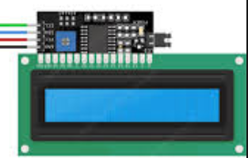
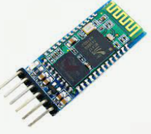
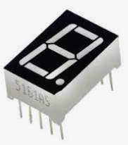
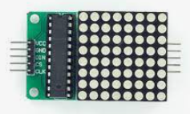
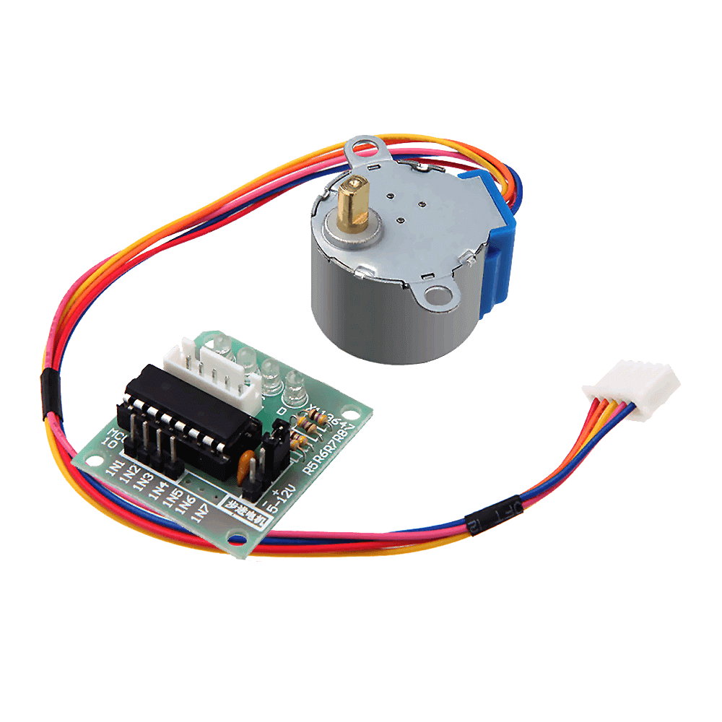
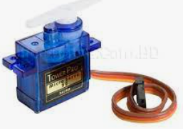
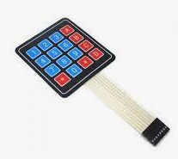
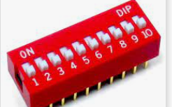
3.2 Design: Components and Software
Components
Nucleo stm32f446re
Lcd display
7-segment display
LED matrix
Sonar
Servo motor
Stepper motor
Speaker
Push button
Dip switch
3-pin switch
keypad
Led
Rgb light
Bluetooth Module
Resistors
Male to female header
Male to male header
Softwares used:
Proteus 8.13 Pro (for PCB designing)
STMCube IDE
Keil µ-Vision 5
Presented by: 1706009

Slide 8
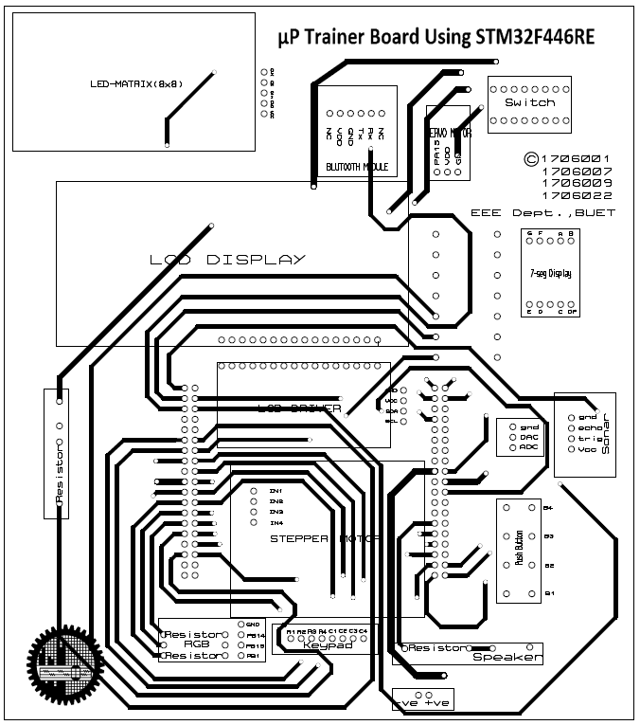
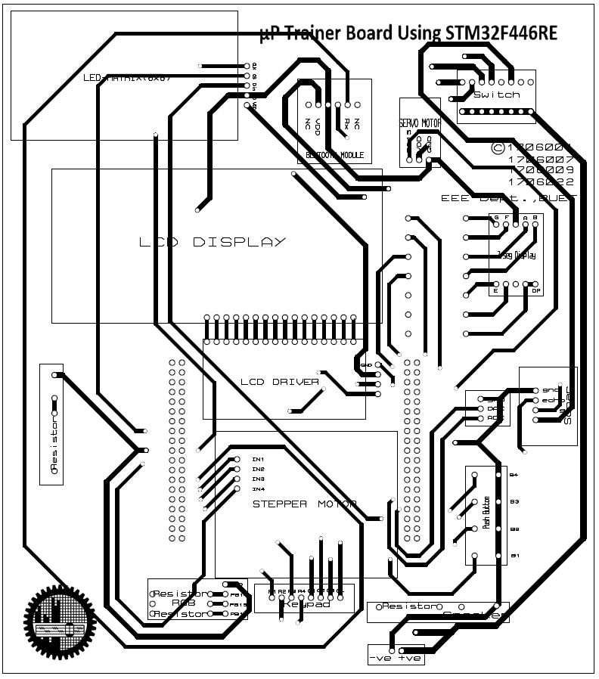
3.2 Design: Circuit Diagram
PCB Circuit diagram:
Presented by: 1706009

Slide 9
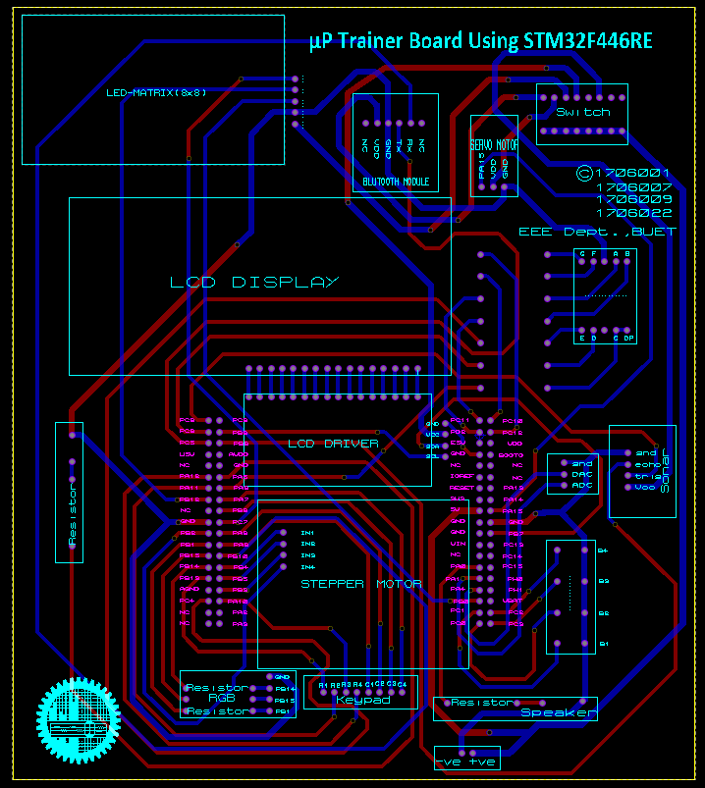
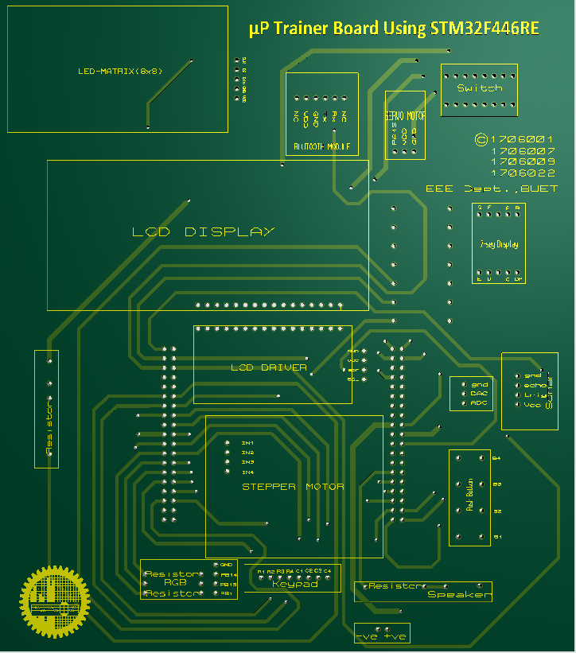
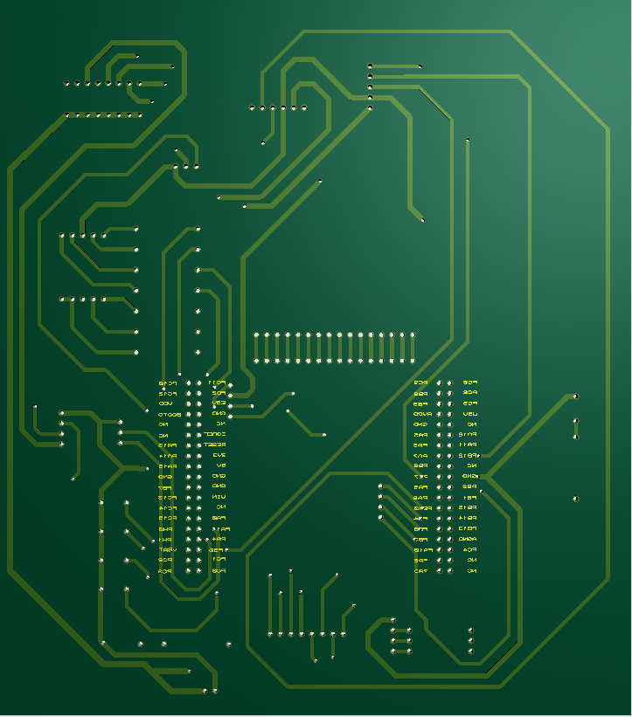
3.4 Design: PCB Layout and 3d rendering
PCB layout design:
Presented by: 1706009

Slide 10
4 Implementation: Demonstration
Presented by: 1706XXX

Slide 11
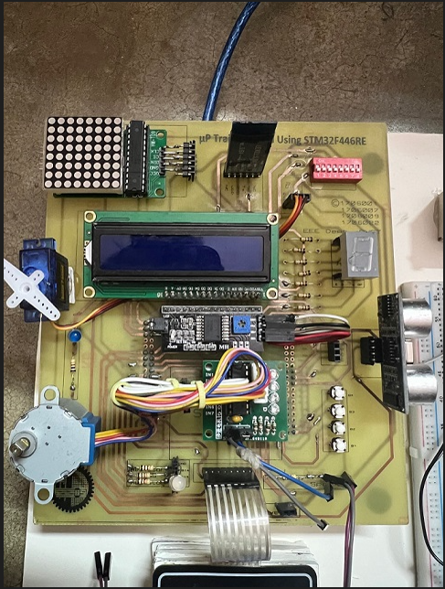
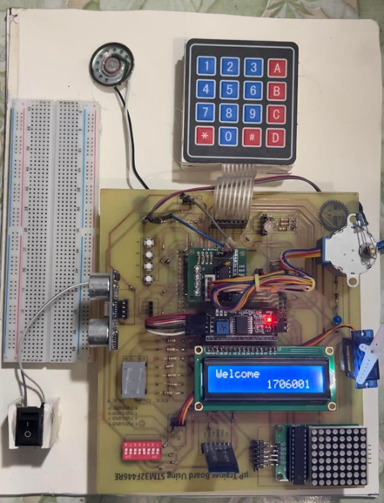
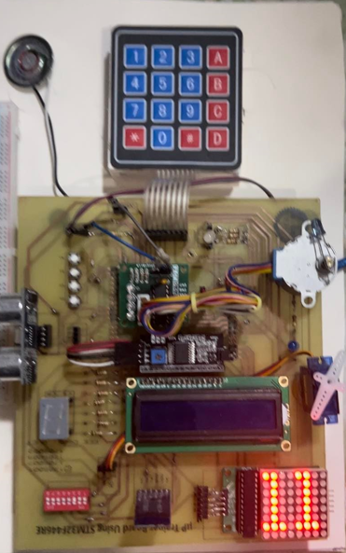
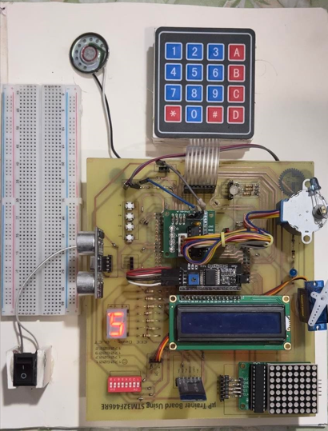
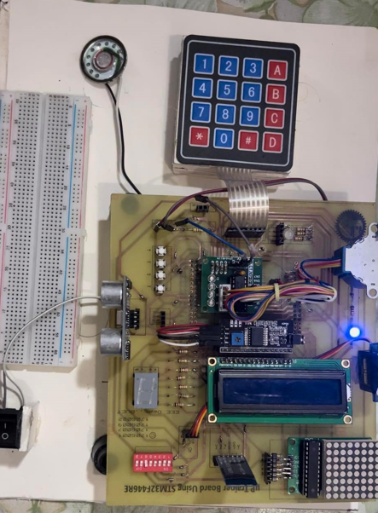
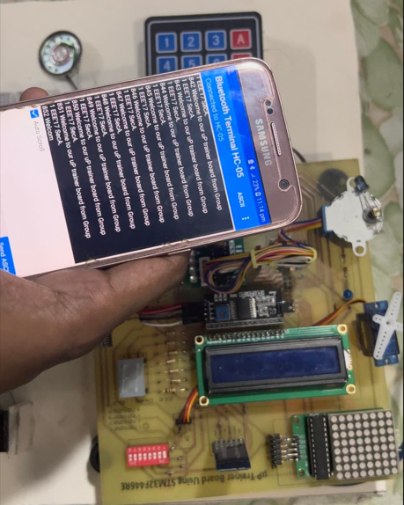
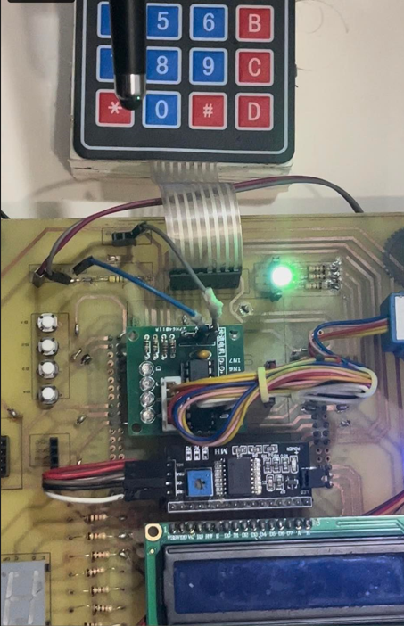
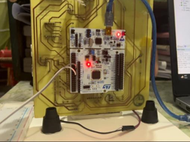
4.1 Implementation: Photo Gallary
Presented by: 1706XXX

Slide 12
4.2 Implementation: External Links
GitHub link:
https://github.com/mrinmoykundu/uP-Trainer-with-STM32f446-microprocessor.git
YouTube Link:
https://www.youtube.com/watch?v=9OJPnnVvqg4
Presented by: 1706XXX

Slide 13
5. Analysis and Evaluation
5.1 Novelty
5.2 Project Management and Cost Analysis
5.3 Practical Considerations of the Design
5.4 Assessment of the Impact of the Project
5.5 Evaluation of the Sustainability
Presented by: 1706007

Slide 14
5.1 Novelty
Unique design incorporating STM32F466RE and various peripherals
Removable modules on the board
Provision of remote control of the trainer board
Isolated power control using DIP switch
External master reset pin
Presented by: 1706007

Slide 15
5.2 Project Management and Cost Analysis
Component name | Quantity | per unit price(tk) | Total Price(tk)
8x8 LED matrix 7219 | 1 | 200 | 200
7 segment | 2 | 10 | 20
8 ohm speaker | 1 | 20 | 20
push buttons | 4 | 3 | 12
Keypad | 1 | 60 | 60
Female-Female wire | 2 bunch | 50 | 100
stm32f446 board | 1 | 1 | 4000
pcb(v1) | 1 | 728 | 728
pcb(v2) | 1 | 800 | 800
Presented by: 1706007

Slide 16
5.2 Project Management and Cost Analysis
Component name | Quantity | per unit price(tk) | Total Price(tk)
DIP 8 pin switch | 1 | 30 | 30
male rail | 4 pieces | 15 | 60
female rail | 5 pieces | 25 | 125
led wire | 4 | 3 | 12
lifting knob | 1 | 60 | 60
47 ohm resistor | 10 pieces | 1 | 10
1k ohm resistor | 10 pieces | 2 | 20
Total |  |  | 6257
Presented by: 1706007

Slide 17
5.3 Practical Considerations of the Design
5.3.1 Considerations to public health and safety
We have no element in the design to cause public safety issue
5.3.2 Considerations to environment
We try to compact our design as far as possible to reduce plastic and carbon footprint
5.3.3 Considerations to cultural and societal needs
Our trainer board can be used as an experimental platform for the upcoming EEE 416 course, thus more focus can be put on the theory of ISA and embedded system instead of the hardware demonstration.
Presented by: 1706007

Slide 18
5.4 Assessment of the Impact of the Project
Making easier embedded system operations
Cost efficient designing example
Easier interfacing with arm architecture-based processor
Presented by: 1706007

Slide 19
5.5 Evaluation of the Sustainability
Nucleo stm32f446re board is a pretty solid board which can even sustain under unwanted short-circuit condition.
All the components on the pcb board were mounted through female/male headers.So, the components are easily removable and can be easily changed/swapped/removed easily if needed.
Presented by: 1706007

Slide 20
6. Reflection on Individual and Team work
6.1 Individual Contribution of Each Member
6.2 Mode of TeamWork
6.3 Diversity Statement of Team
6.4 Log Book of Project Implementation
Presented by: 1706001

Slide 21
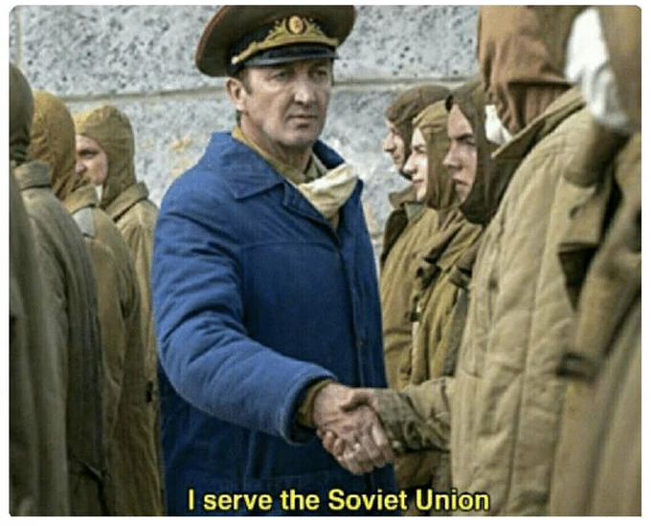
6.1 Individual Contribution of Members
Background study
Hardware prototype testing
PCB Designing
Printing, Soldering and Circuit testing
Purchasing of various components
Integration of each modules
Coding
Debugging and troubleshooting
Final Demonstration
Equal contribution from each member
1706001
1706007
1706009
1706022
Presented by: 1706001

Slide 22
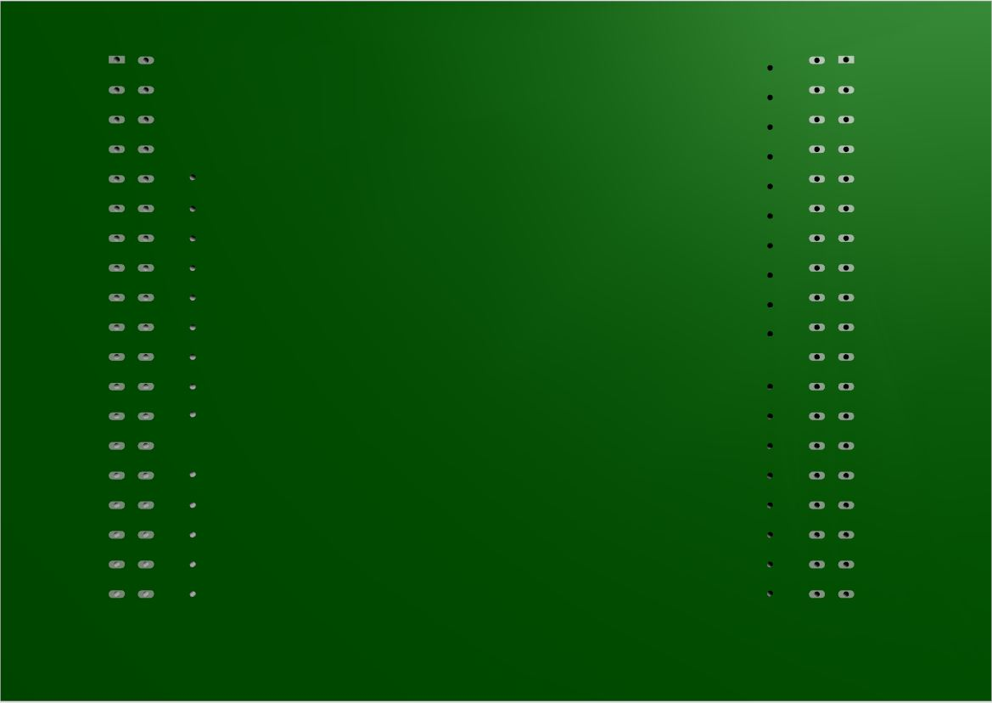
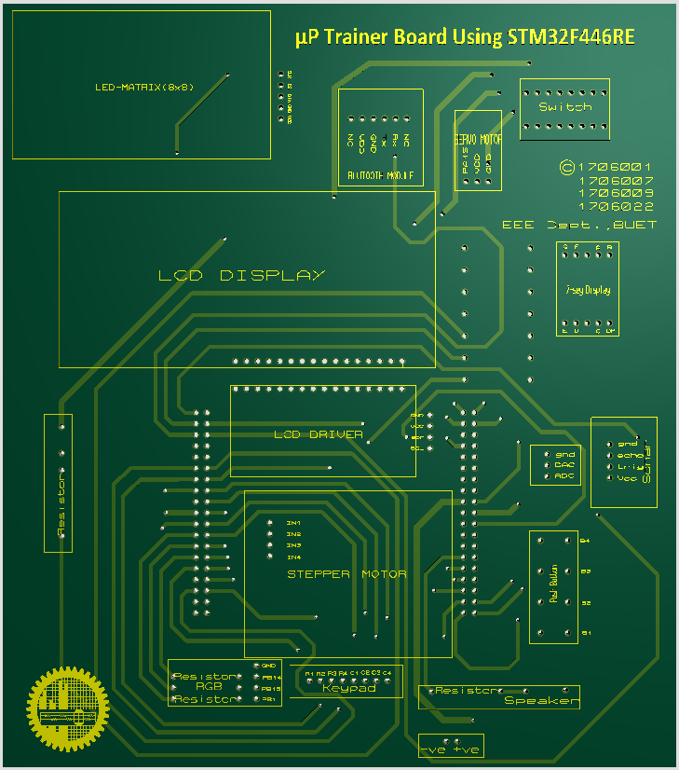
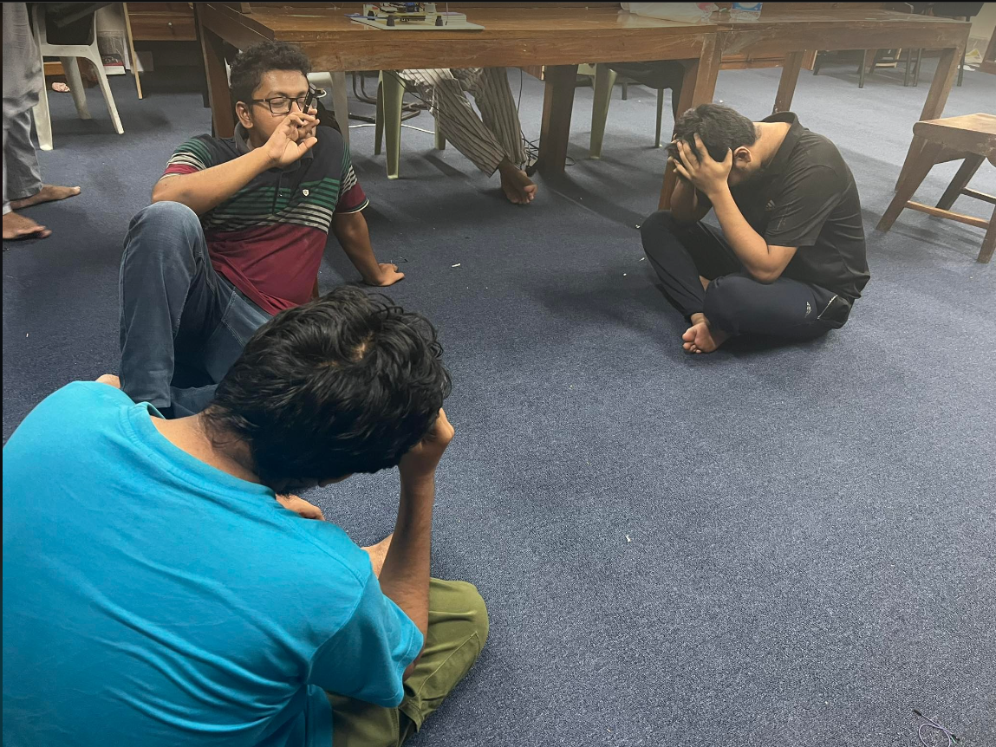
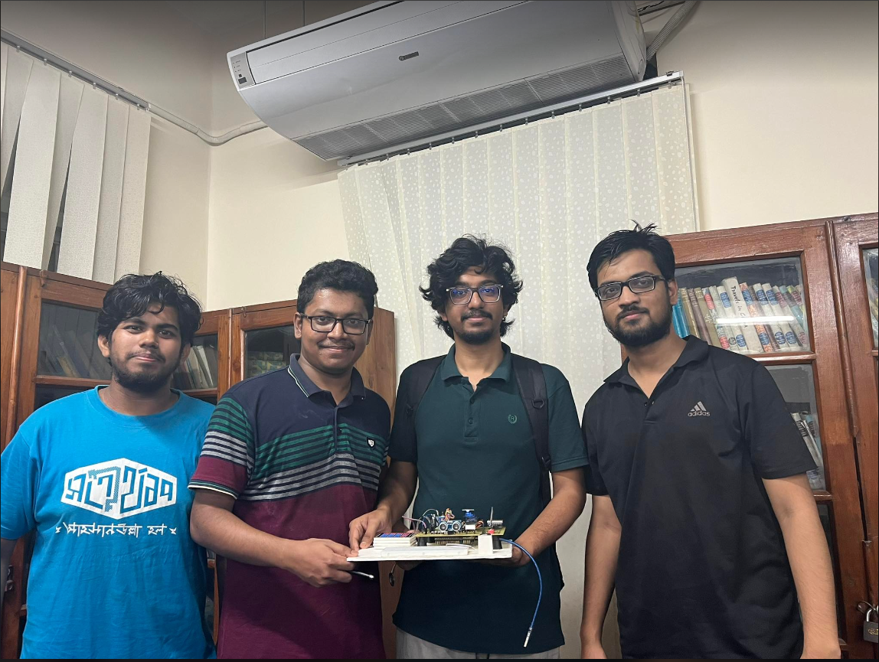
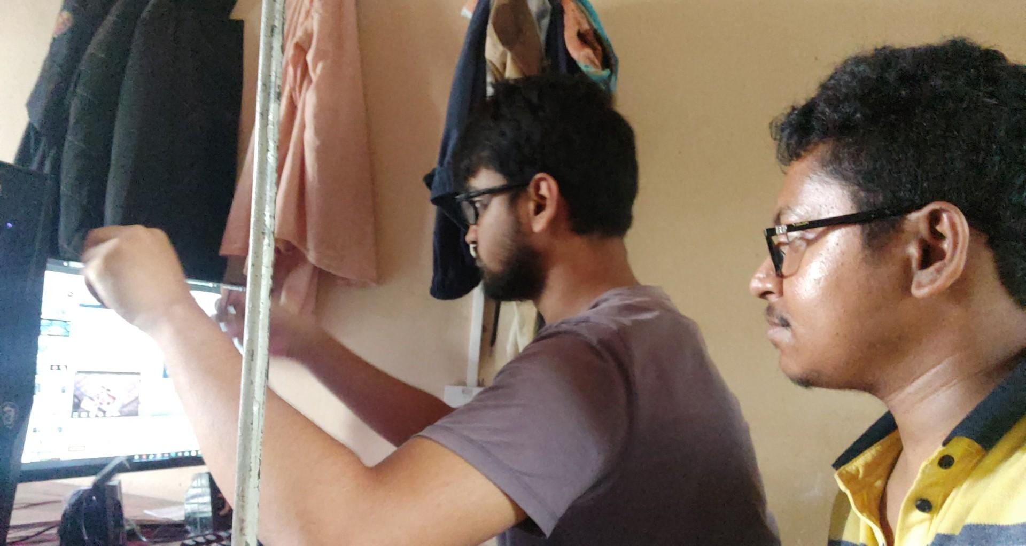
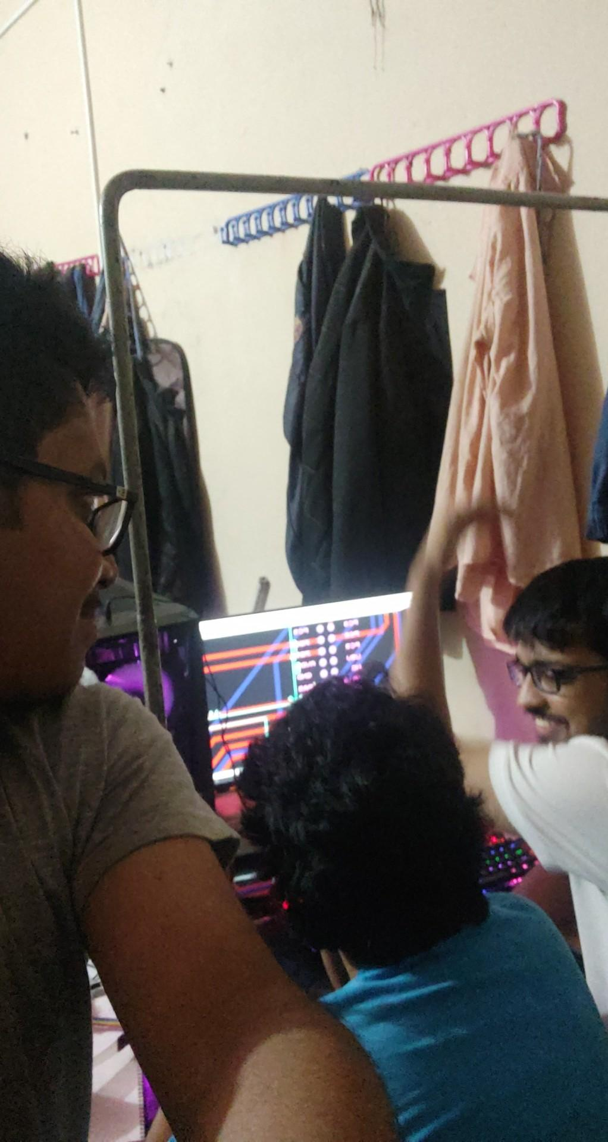
6.2 Mode of TeamWork and Diversity
Diversity : From different major
Pre Planning and organization, pushing and supporting each other, brainstorming as a teams
Before
After
Frustration of not being successful
Happy faces after completion of the project
Presented by: 1706001

Slide 23
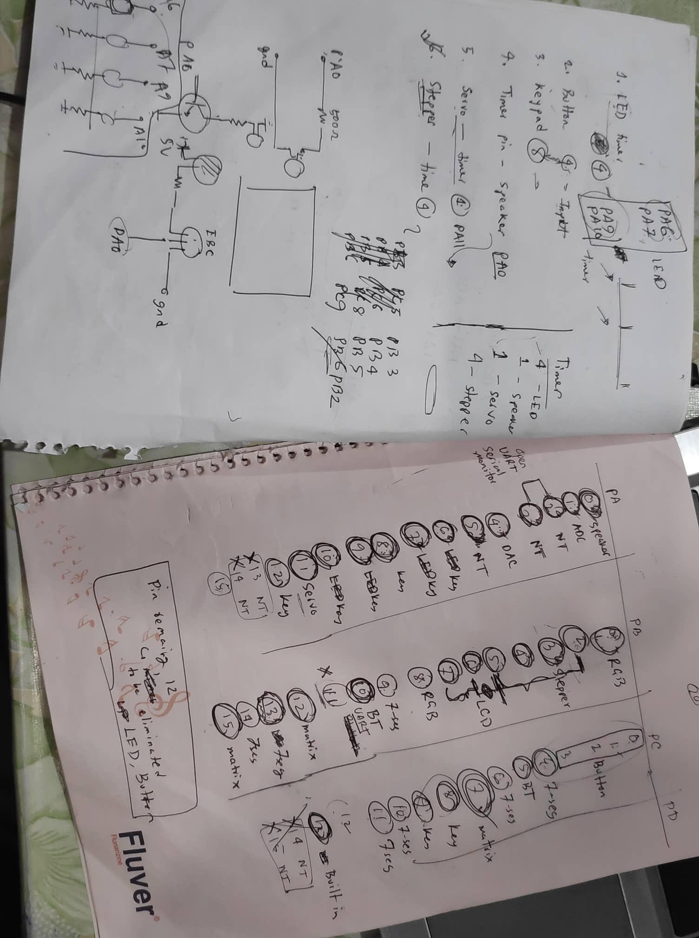
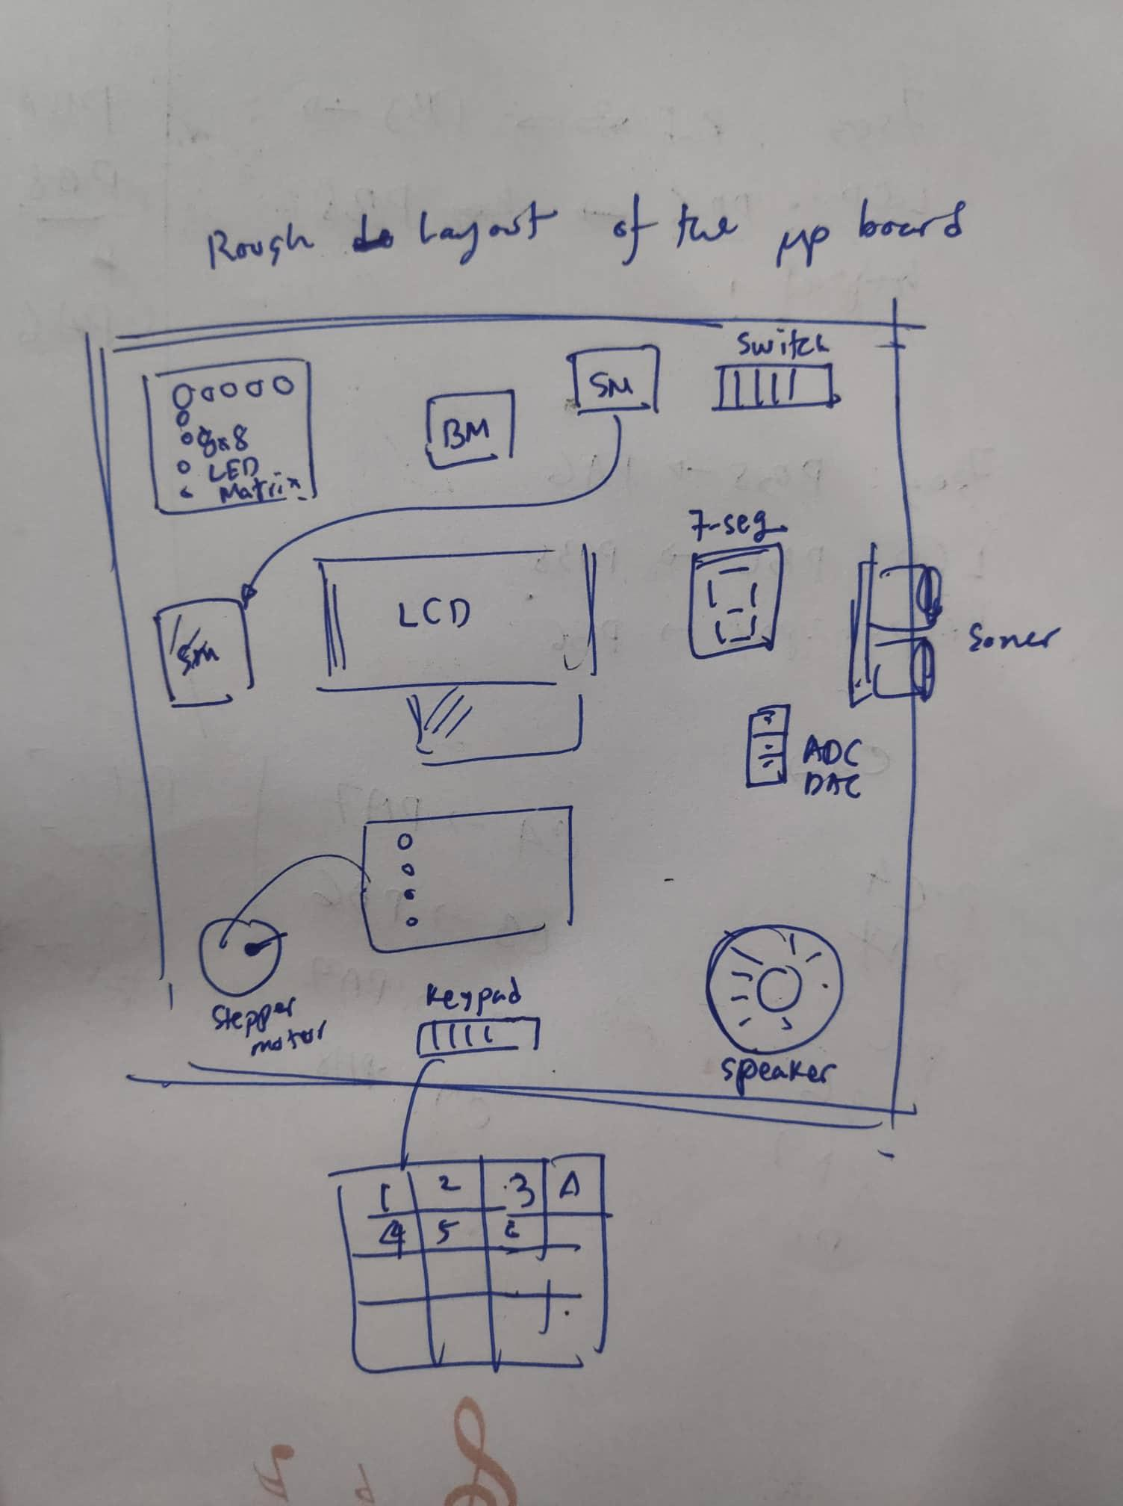
6.3 Logbook of Project
Working plans on different phases of project:
Presented by: 1706001

Slide 24
6.4 Difficulties and Future Outlook
Future Outlook:
As 8-pin dip switch,external push button and an additional breadboard were provided, more customization are possible.
Additional esp32 can be used to add wireless operations and control the board externally.
more and more led matrix can be added to make bigger displays for multiple operations such as live watch and etc.
If provided with enough technological support, more smarter and compact printed circuit board (pcb) can be designed.
Difficulties
First ever experience with PCB designing.
Pins allocating for different operations was difficult as only 39 number of pins were available to use.
Soldering was quite difficult as we have to compact the PCB for cost minimization and a lot of connections needed to be soldered which were just 2.54mm apart from each other.
Lack of available resources.
Lack of decent commercial organization for fabricating pcb.
Presented by: 1706001

Slide 25
7. References
Details intuition of STM32F446 Microcontroller
Youtube videos containing basic theoretical knowledge of STM32F446 Microcontroller
Details view & intuition of GPIO pins
Proteus Tutorial : Getting Started with Proteus PCB Design (Version 8.6)
Presented by: 1706001

Slide 26
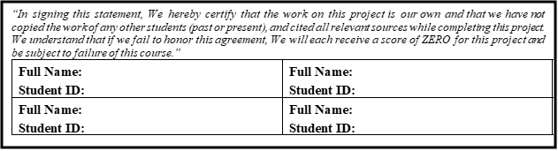

Mrinmoy Kundu
Jahid Hasan Tushar
1706001
1706009
Md. Rafiqul Islam Rafi
Voktho Das
1706007
1706022
Presented by: 1706001

